Slide 1

Social Networks
Chris Piech
CS106A, Stanford University

Slide 2
Download the Chat Client!

Slide 3
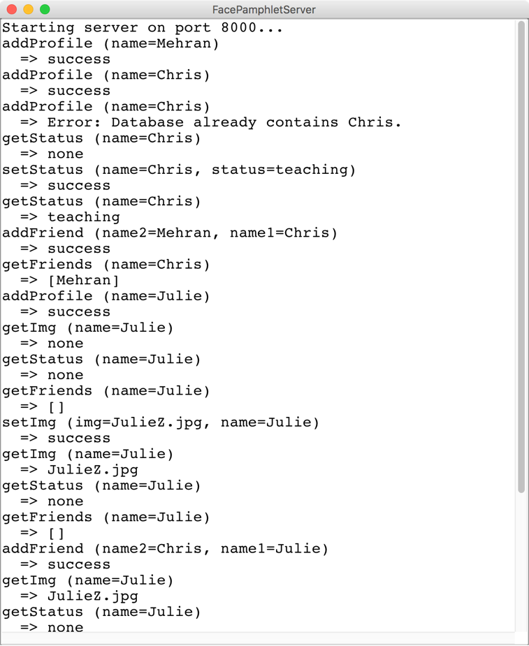
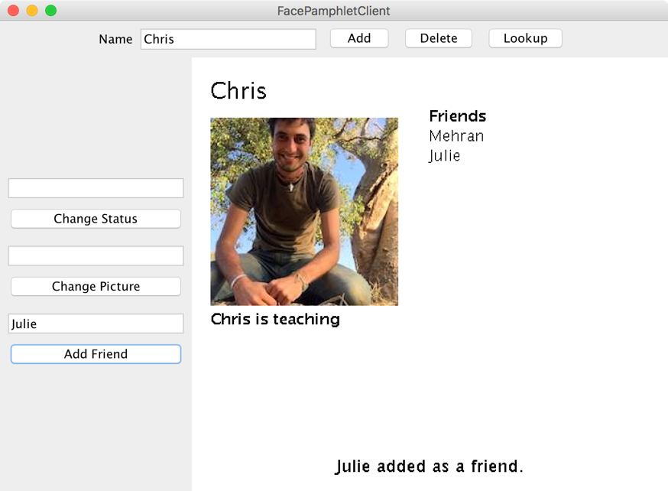
Face Pamphlet
FacePamphletServer
FacePamphletClient

Slide 4
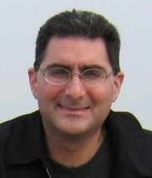

The Name
+
FaceBook
Thanks Mehran for the cool name

Slide 5

The Name
+
FaceLittlebook
Thanks Mehran for the cool name

Slide 6

The Name
+
FaceNovela
Thanks Mehran for the cool name

Slide 7

The Name
+
!!
FacePamphlet
Thanks Mehran for the cool name

Slide 8
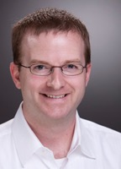

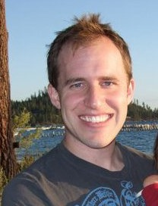
Some Context
A little background on Facebook
Facebook founded in 2004 by Mark Zuckerberg
He was a sophomore at Harvard
Facebook in 2012
More than 1 billion active users
10+ billion minutes/day spent on Facebook
You can do this!
Mike Schroepfer (Vice President, Engineering)
Jocelyn Goldfein (Director, Engineering)
Bret Taylor (former Chief Technology Officer)
All three were CS majors at Stanford
And all are former CS106A section leaders!

Slide 9
Review

Slide 10
Background: The Internet
The internet is just many programs sending messages (as Strings)
Thanks Nick for the teaching YEAH

Slide 11
Background: The Internet
Facebook datacenter
Your computer (facebook.com)
The internet is just many programs sending messages (as Strings)
Thanks Nick for the teaching YEAH

Slide 12
Background: The Internet
Facebook datacenter
Your computer (facebook.com)
“Server”
“Client”
The internet is just many programs sending messages (as Strings)
Thanks Nick for the teaching YEAH

Slide 13
Background: The Internet
Facebook datacenter
Your computer (facebook.com)
Get status for “Nick Troccoli”
“Server”
“Client”
The internet is just many programs sending messages (as Strings)
Thanks Nick for the teaching YEAH

Slide 14
Background: The Internet
Facebook datacenter
“response”
Your computer (facebook.com)
“teaching YEAH”
Get status for “Nick Troccoli”
“Server”
“request”
“Client”
The internet is just many programs sending messages (as Strings)
Thanks Nick for the teaching YEAH

Slide 15
Face Book Server
Send the status for
piech@cs.stanford.edu
Chris Piech
“Teaching”
Status: Chris is teaching
Set status:

Slide 16
FacePamphlet
FacePamphletServer
FacePamphletClient
RESPONSE
REQUEST
“Server”
“Client”
Your task
Extra credit
Thanks Nick for the teaching YEAH
Notes:
Respond to all the requests the client could send! (Each internet program has its own “protocol” for what messages it sends)

Slide 17
Another way to get Server/Client
First, imagine a world before Server/Clients…
Interacts with user /
displays information
FaceDatabase
FaceProfile
FaceGraphics
Stores information
* This blob represents one program on one machine

Slide 18
Another way to get Server/Client
First, imagine a world before Server/Clients…
FaceDatabase
FaceProfile
FaceGraphics
* This blob represents one program on one machine

Slide 19
Another way to get Server/Client
Now our application runs across two programs
Client
Server
RESPONSE
FaceGraphics
FaceDatabase
REQUEST
FaceProfile
* Each blob represents one program on one machine

Slide 20
Another way to get Server/Client
Which means many clients can connect to the data
Client
Server
RESPONSE
FaceGraphics
FaceDatabase
REQUEST
FaceProfile
RESPONSE
Client
FaceGraphics
REQUEST
* Each blob represents one program on one machine

Slide 21
Many computers can connect to the same server

Slide 22
The Internet
Facebook datacenter
RESPONSE
REQUEST
REQUEST
Your mom’s computer
(linux shell)
RESPONSE
“Server”
Tate Ole Keko’s computer (facebook.com)
Chris’ phone (facebook app)
“Client”
“Client”
“Client”

Slide 23
Most of the Internet
Aka “the frontend”
Aka “the backend”
Server / Clients
Aka “the cloud”
Aka “the GUI”
Aka “the brains”

Slide 24
For the first time ever in CS106A...

Slide 25
(technically the second time because we saw this yesterday)

Slide 26
Servers on one slide
public String requestMade(Request request) {
// server code goes here
}
1
2
// make a Server object
private SimpleServer server
= new SimpleServer(this, 8000);
3
public void run(){
// start the server
server.start();
}

Slide 27
Servers on one slide
public String requestMade(Request request) {
// server code goes here
}
1
2
// make a Server object
private SimpleServer server
= new SimpleServer(this, 8000);
3
public void run(){
// start the server
server.start();
}

Slide 28
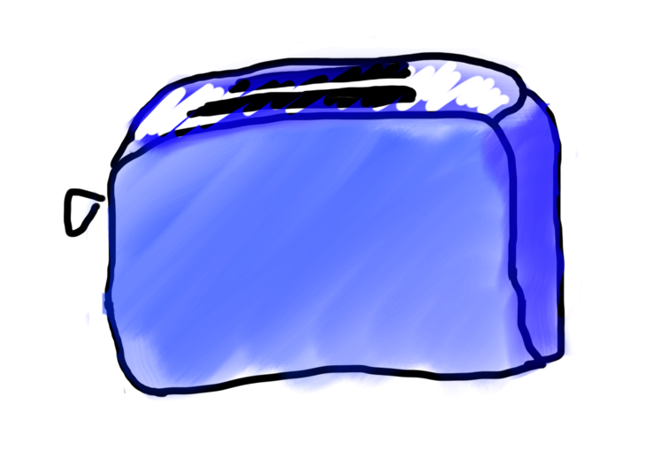
Requests are like Remote Method Calls
Server has a bunch of discrete things it can do
Server
makeToast
getChocolate

Slide 29
Requests are like Remote Method Calls
Server
makeToast
getChocolate

Slide 30
Requests are like Remote Method Calls
request.getCommand();
=> ”makeToast”
Server
makeToast
getChocolate

Slide 31

Requests are like Remote Method Calls
To make toast, I need a parameter which is the kind of bread
makeToast

Slide 32
Requests are like Remote Method Calls
I was given a parameter!
makeToast

Slide 33
Requests are like Remote Method Calls
request.getParam(“bread”)
makeToast

Slide 34

Requests are like Remote Method Calls
makeToast

Slide 35

Requests are like Remote Method Calls
makeToast

Slide 36


Requests are like Remote Method Calls

Slide 37

public String requestMade(Request request) {
String cmd = request.getCommand();
if(cmd.equals(“makeToast”)) {
Bread input = request.getParam(“bread”);
Bread output = runToaster(input);
???
}
...
}
return output.toString();
.toString()???

Slide 38

Requests are like Remote Method Calls

Slide 39
Requests are like Remote Method Calls

Slide 40
Requests are like Remote Method Calls

Slide 41
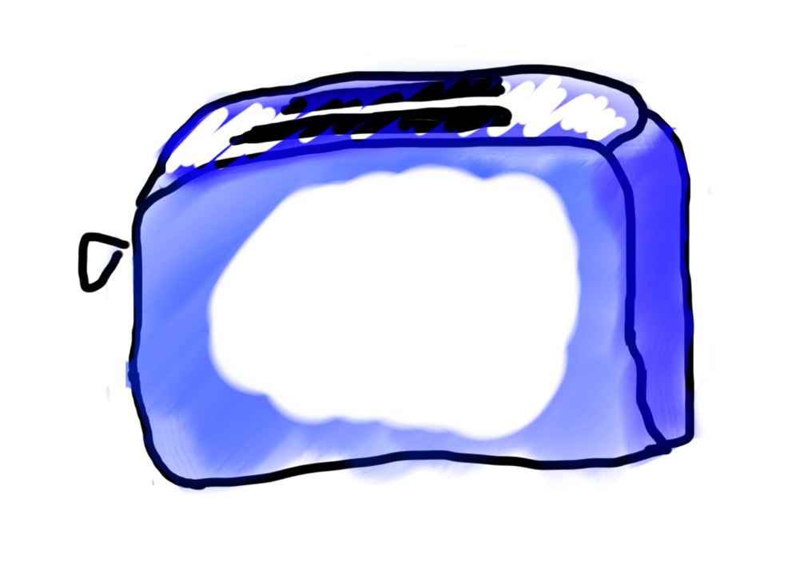
Requests are like Remote Method Calls

Slide 42

Requests are like Remote Method Calls

Slide 43
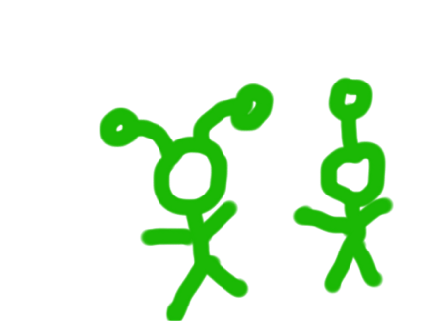
Requests are like Remote Method Calls

Slide 44
What is a Request?
/* Request has a command */
String command;
/* Request has parameters */
HashMap<String,String> params;
Request request
// methods that the server calls on requests
request.getCommand();
request.getParam(key); //returns associated value

Slide 45
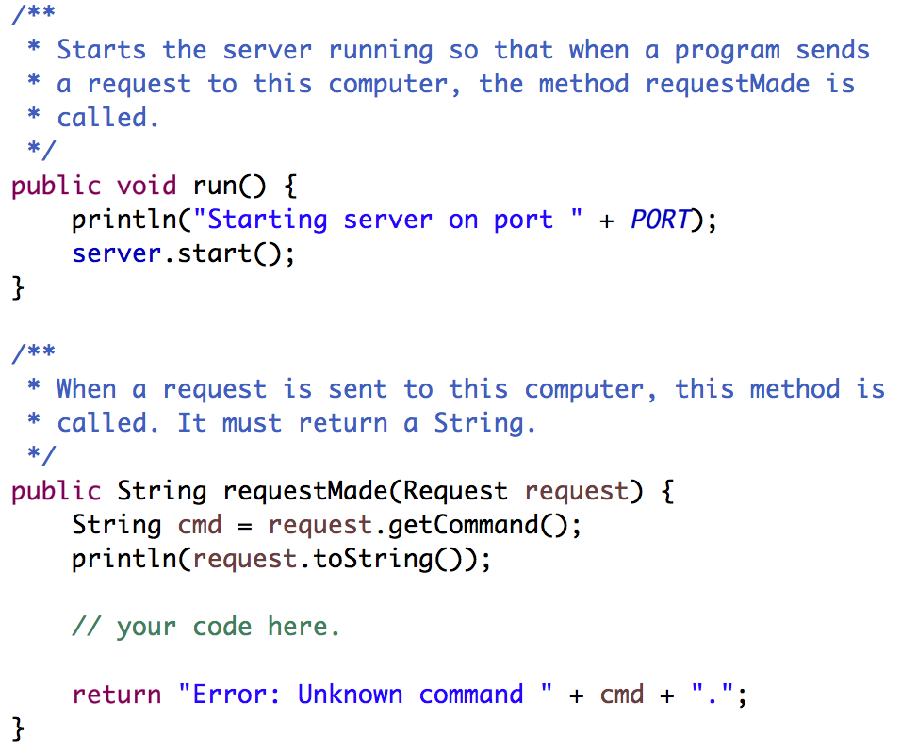
Your Server Code
Respond to requests here. The String you return will be sent as the response.
Notes:
What is a request? A way to structure messages so they’re consistent and easy to understand.

Slide 46
Where we left off...

Slide 47
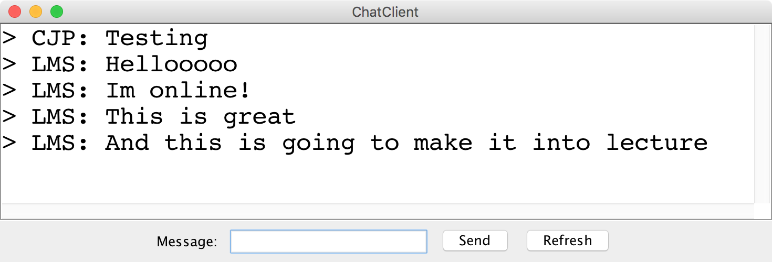
Chat Server and Client

Slide 48
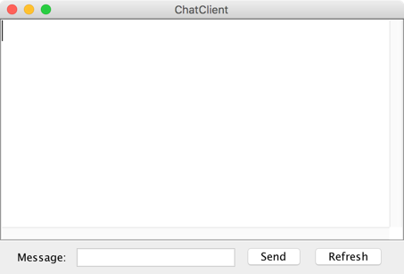
history = [
]
addMsg
msg = Hello world
Chat Client
Chat Client
Send
Hello world
Send

Slide 49
history = [
Hello world
]
getMsgs
index = 0
Chat Client
Chat Client
Send
Send

Slide 50
Chat Server
addMsg
msg = text
Chat Server
getMsgs
index = startIndex

Slide 51
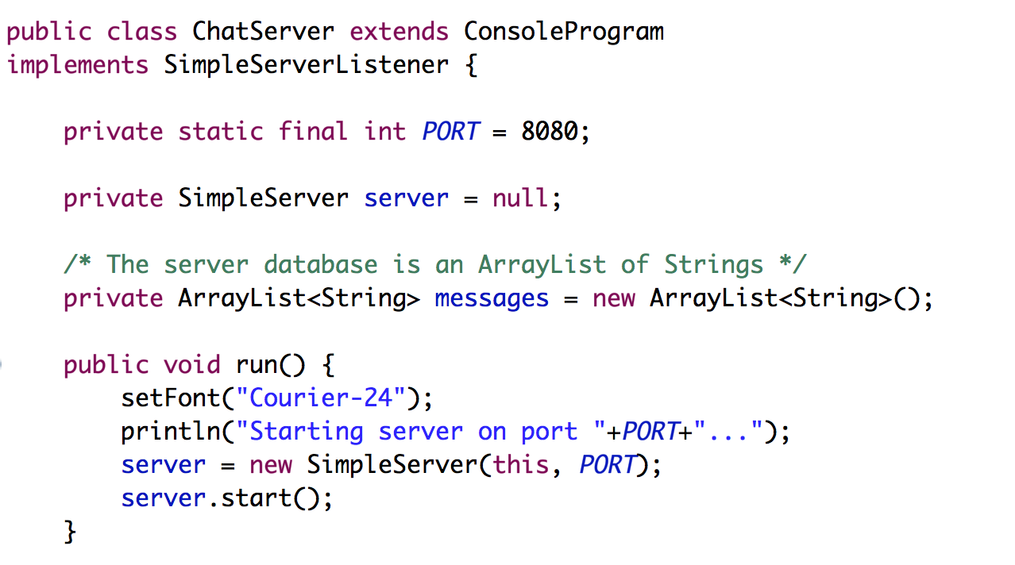
Chat Server
… that’s not all

Slide 52
Chat Server
… that’s not all

Slide 53
Chat Server
… that’s not all

Slide 54
Chat Server
… that’s not all

Slide 55
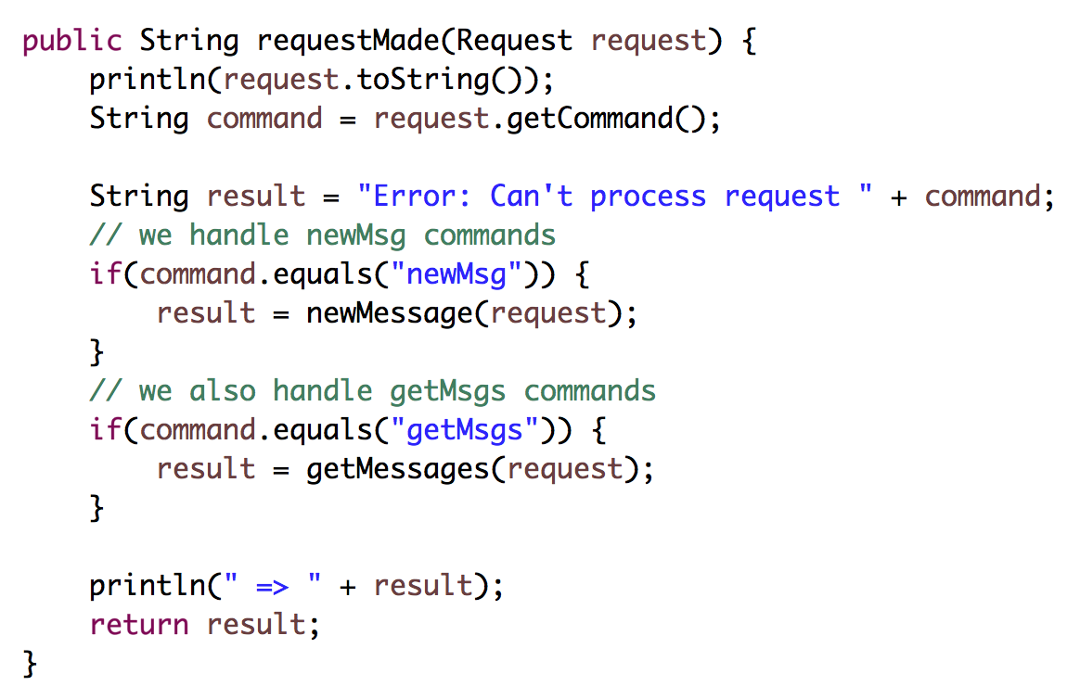
Chat Server (continued)

Slide 56
Chat Server (continued)

Slide 57
Chat Server (continued)

Slide 58
Chat Server (continued)

Slide 60
FAQ

Slide 61
Question: This is cool Chris.
But didn’t you just really
dumb down servers?

Slide 62
Answer: No

Slide 63
Question: Why isn’t this in a browser?

Slide 64
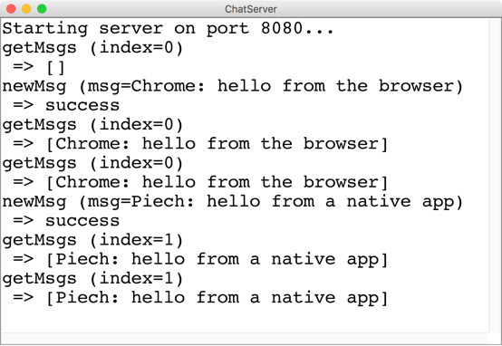
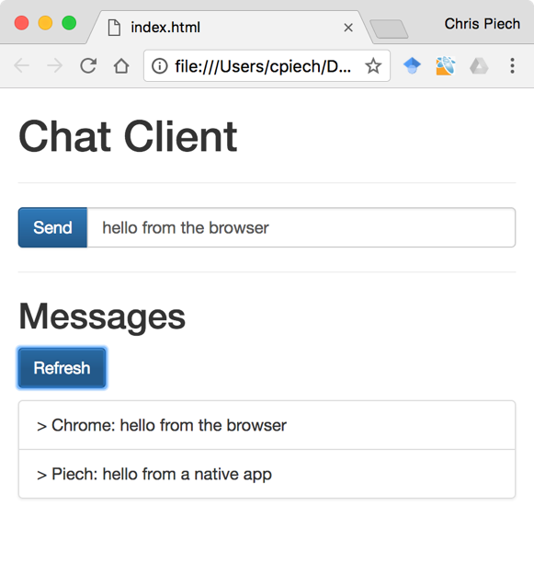
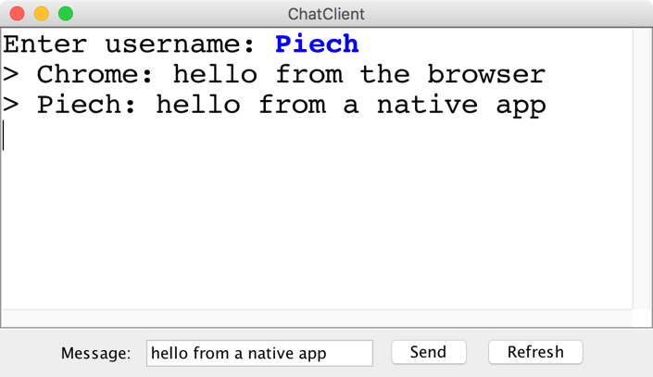
“Native” vs “Browser”

Slide 65
Question: Localhost forever?

Slide 66
Use ngrok to get a url

Slide 68
Any security holes?

Slide 69
Want to learn more?
CS144 Computer Networking
Or CS193P
Or CS193A
Or CS108

Slide 70
Social Networks

Slide 71

Who Do You Love
Who do you love?
And how does Facebook know?

Slide 72
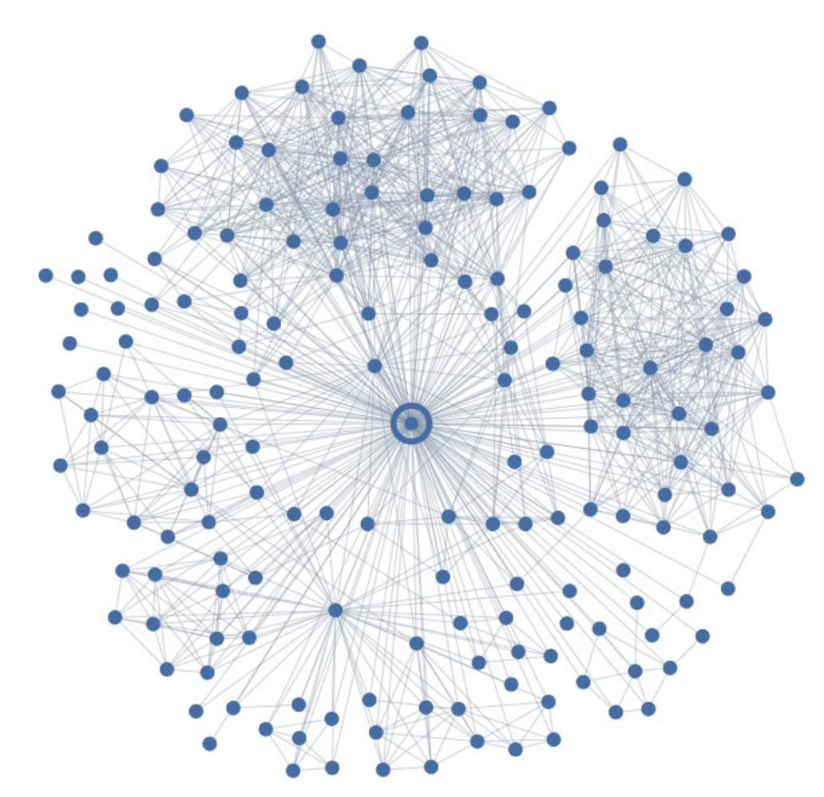
Ego Graph
Your local social network

Slide 73
Maybe I Love These People?
You have some “groups”

Slide 74
But I Actually Love This Person
But here is the love of your life
Your significant other
George

Slide 75
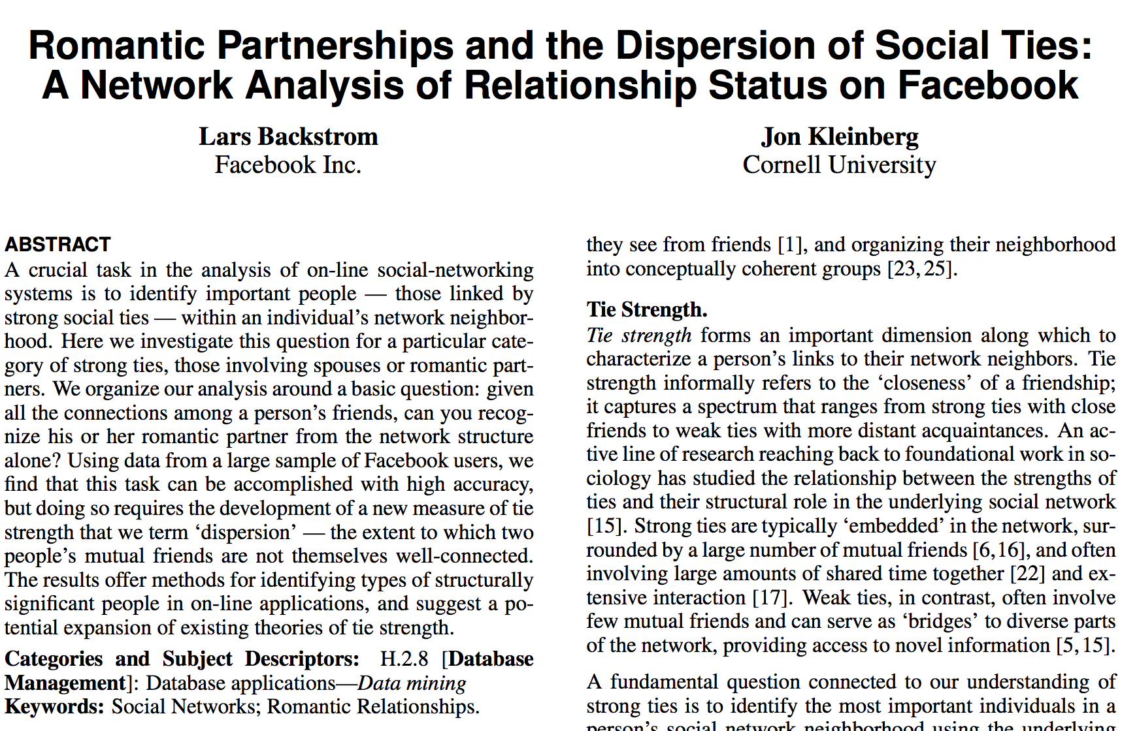
Romance and Dispersion
Romance and Social Networks
October 2013
http://arxiv.org/pdf/1310.6753v1.pdf

Slide 76
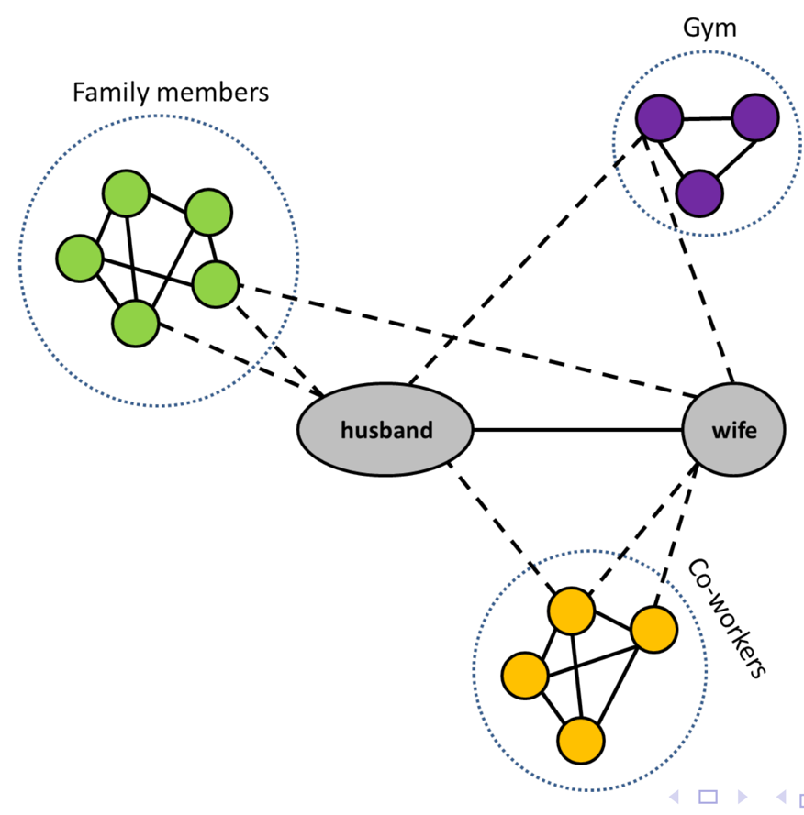
Dispersion Insight
Romance and Social Networks
Dispersion: The extent to which two people’s
mutual friends are not directly connected

Slide 77
The filter bubble

Slide 78
The end.

